Slide 1
ATM_topo updating checks
b.e21.B1850G.f09_g17_gl4.CMIP6-ssp534os-withism.001

Slide 2
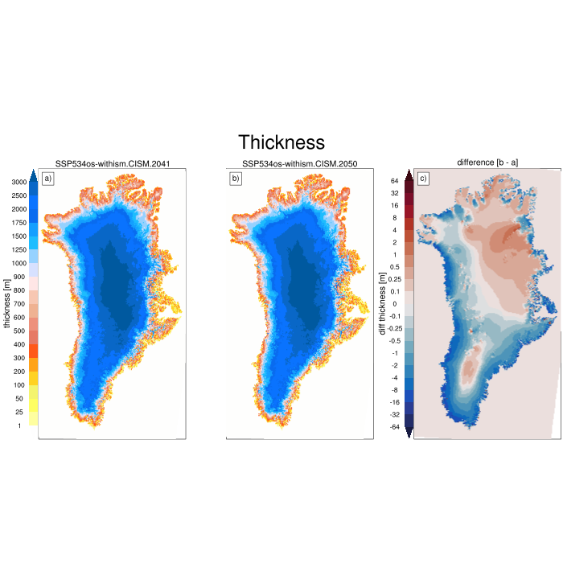
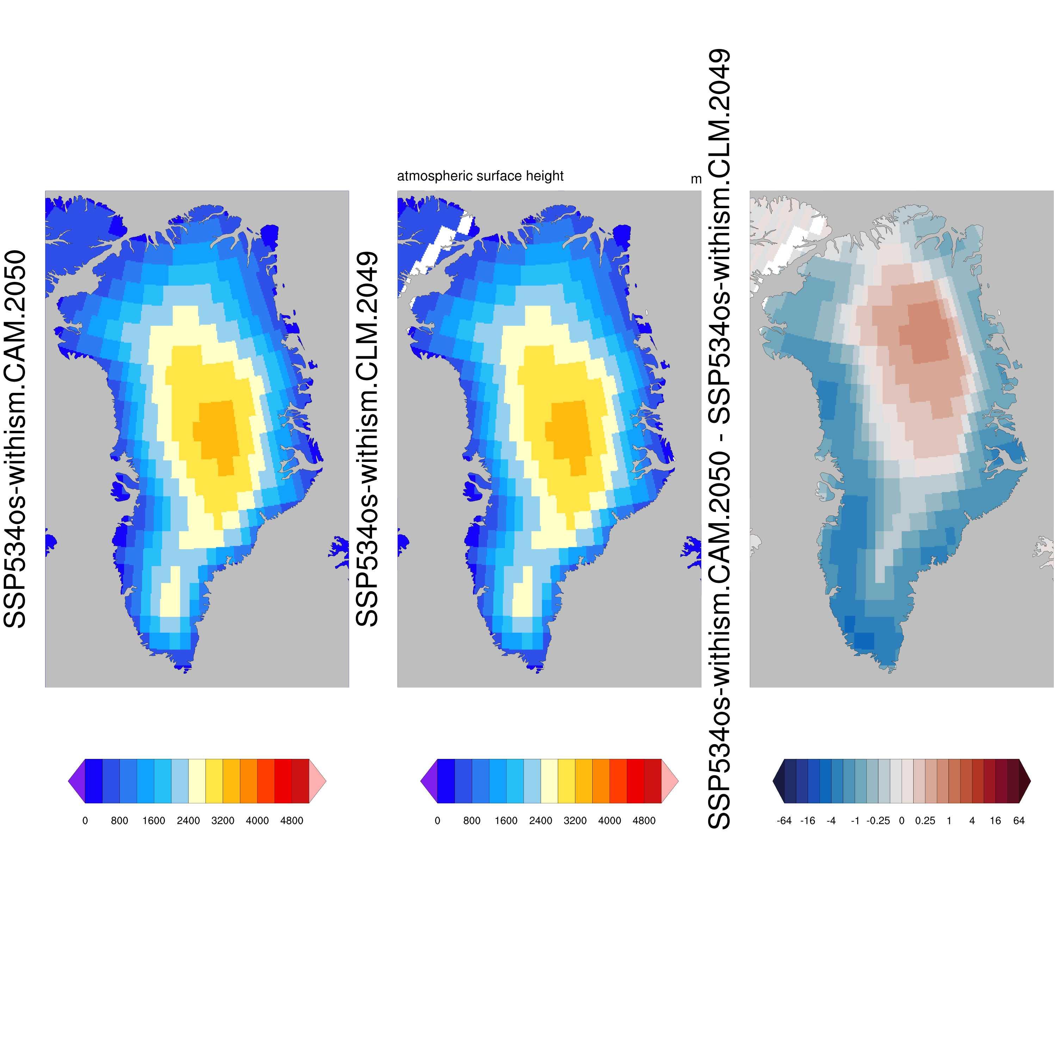
2049 – 2050 OK
Interpretation
Left: CISM thickness difference between years 2041 and 2050
Right a) CAM restart file of 01-01-2050 (left panel) with updated topo, and
b)CLM output 01-12-2049 before updating
c) difference, this should map the 9-year acculumated CISM thk difference

Slide 3
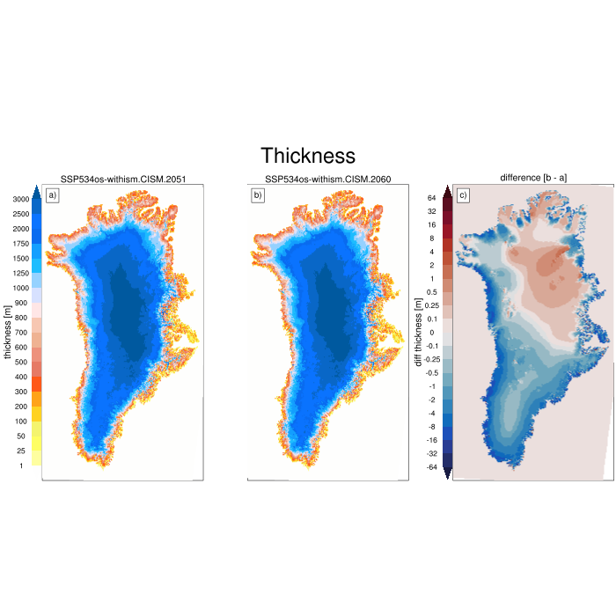
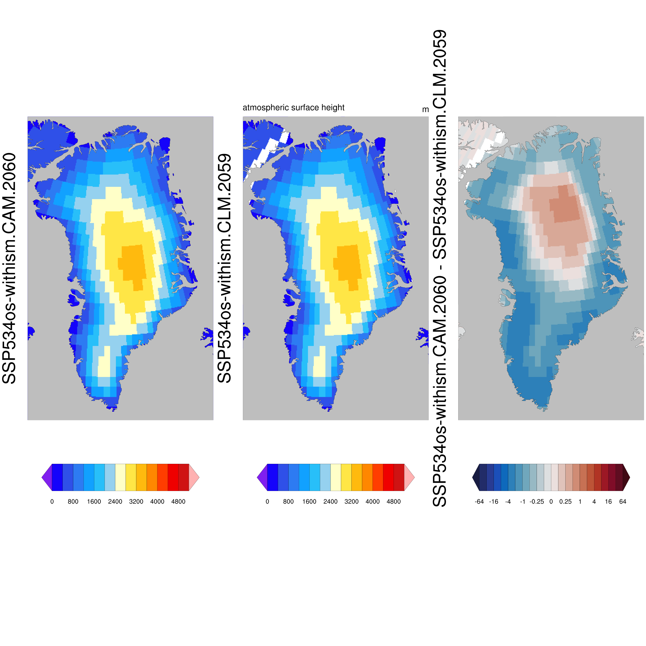
2059 – 2060 OK

Slide 4
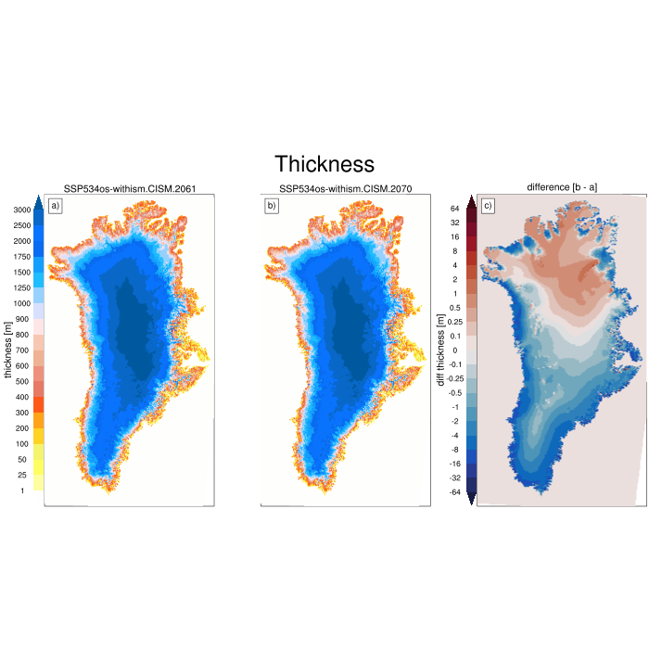
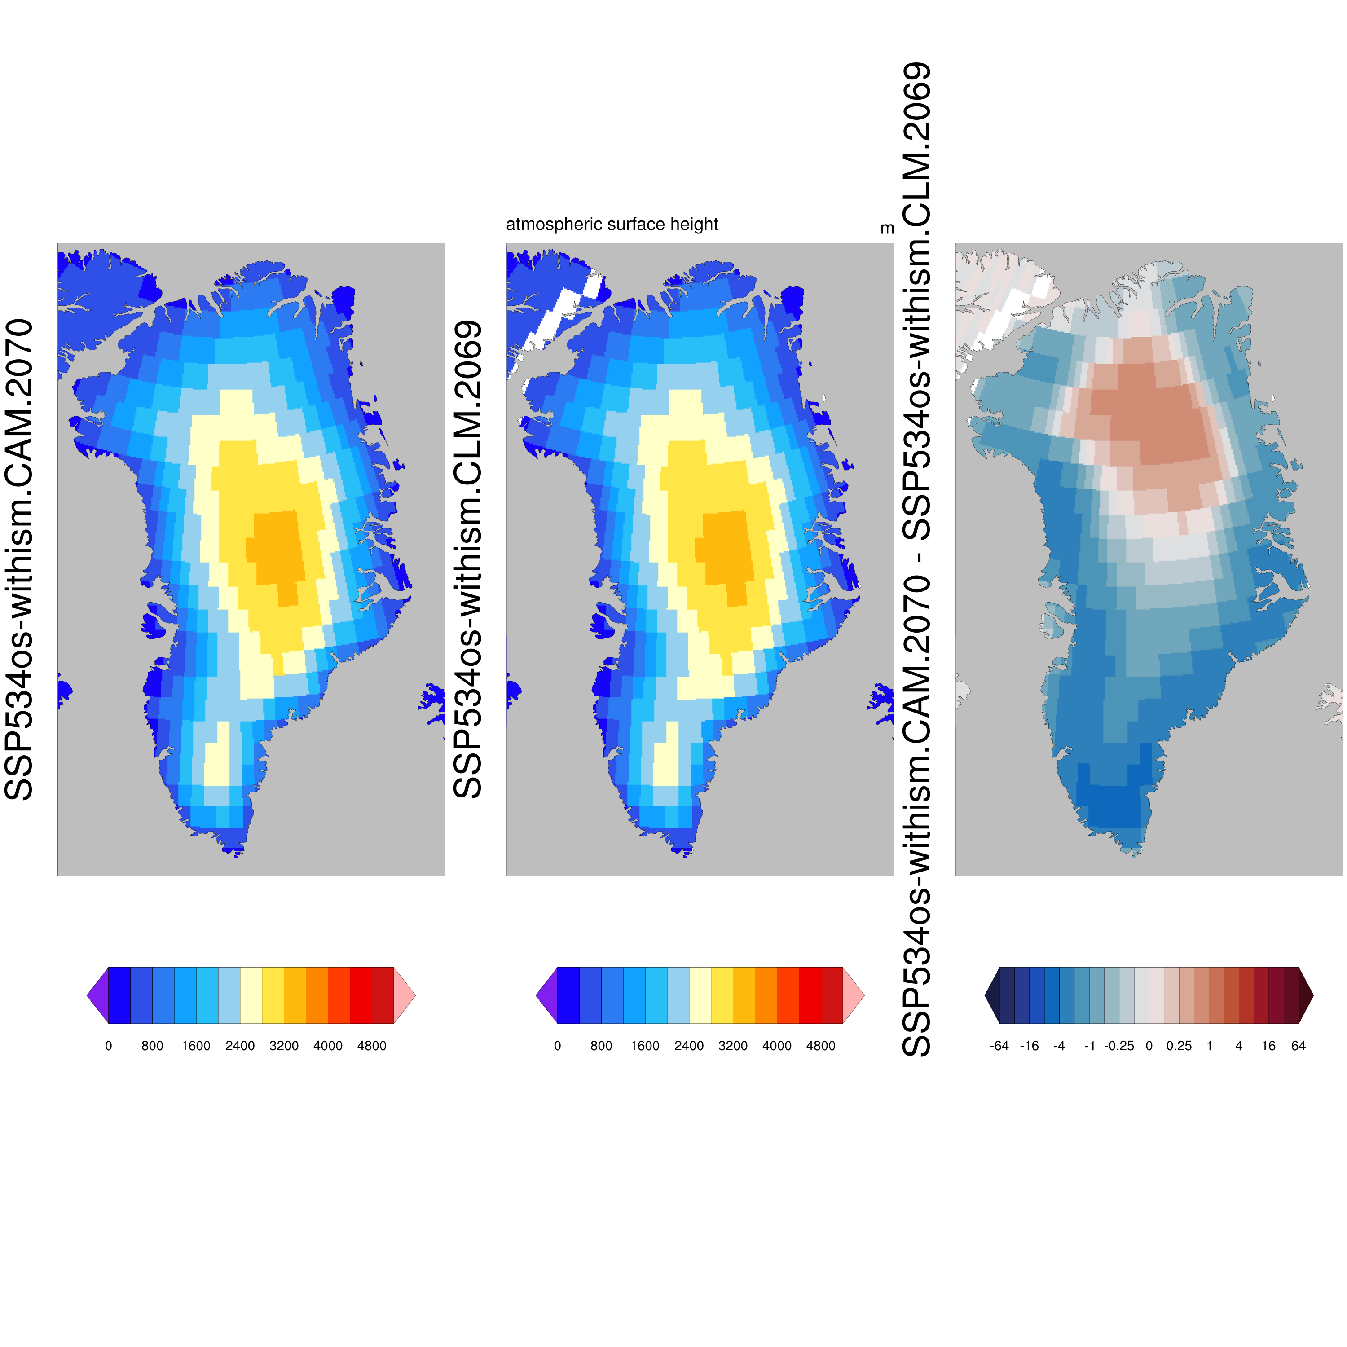
2069 – 2070 OK

Slide 5
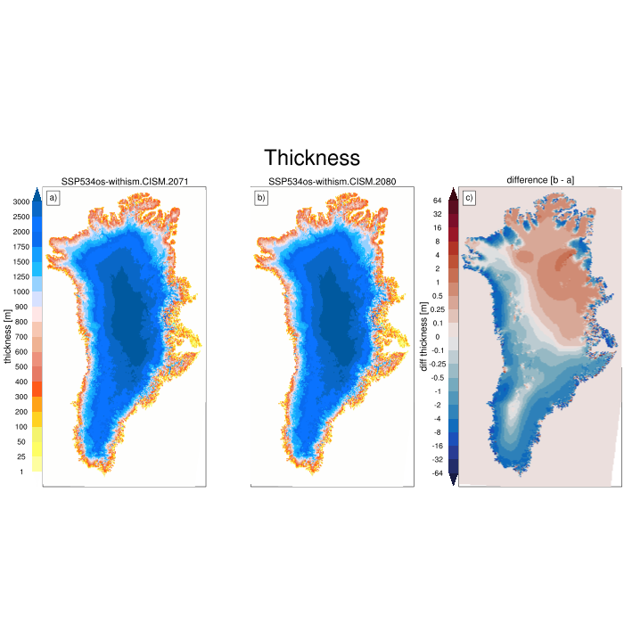
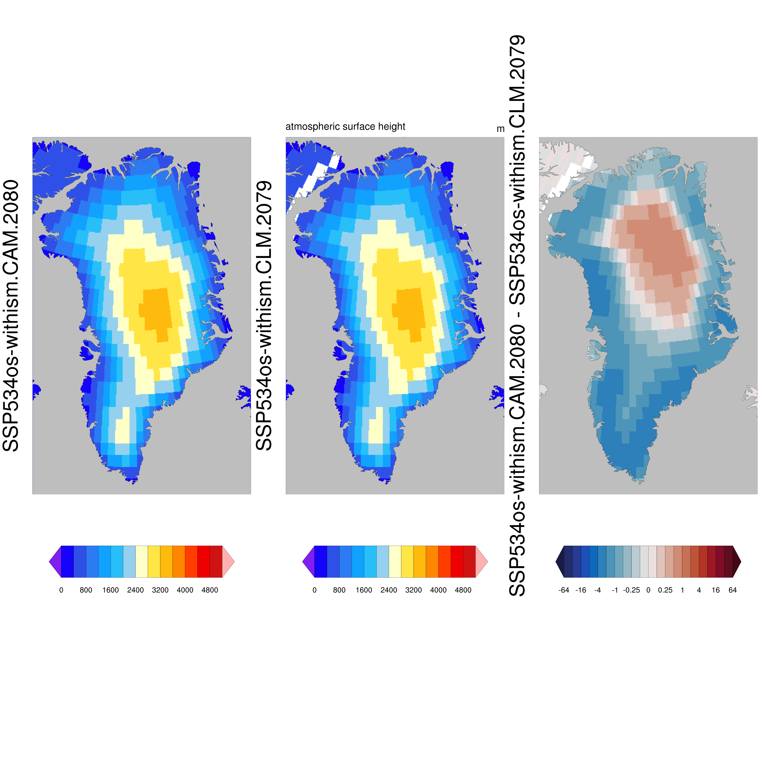
2079 – 2080 OK

Slide 6
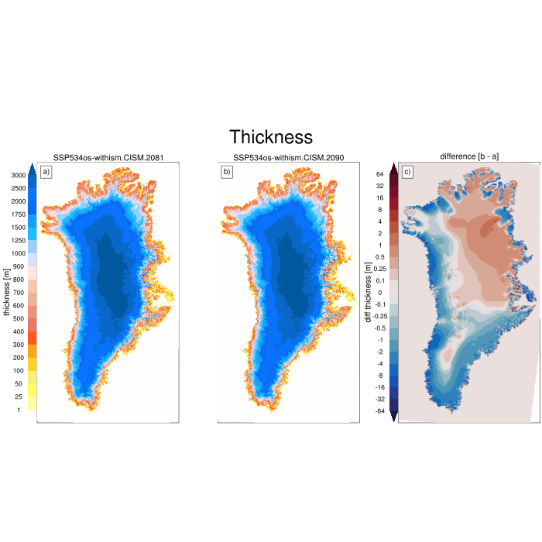
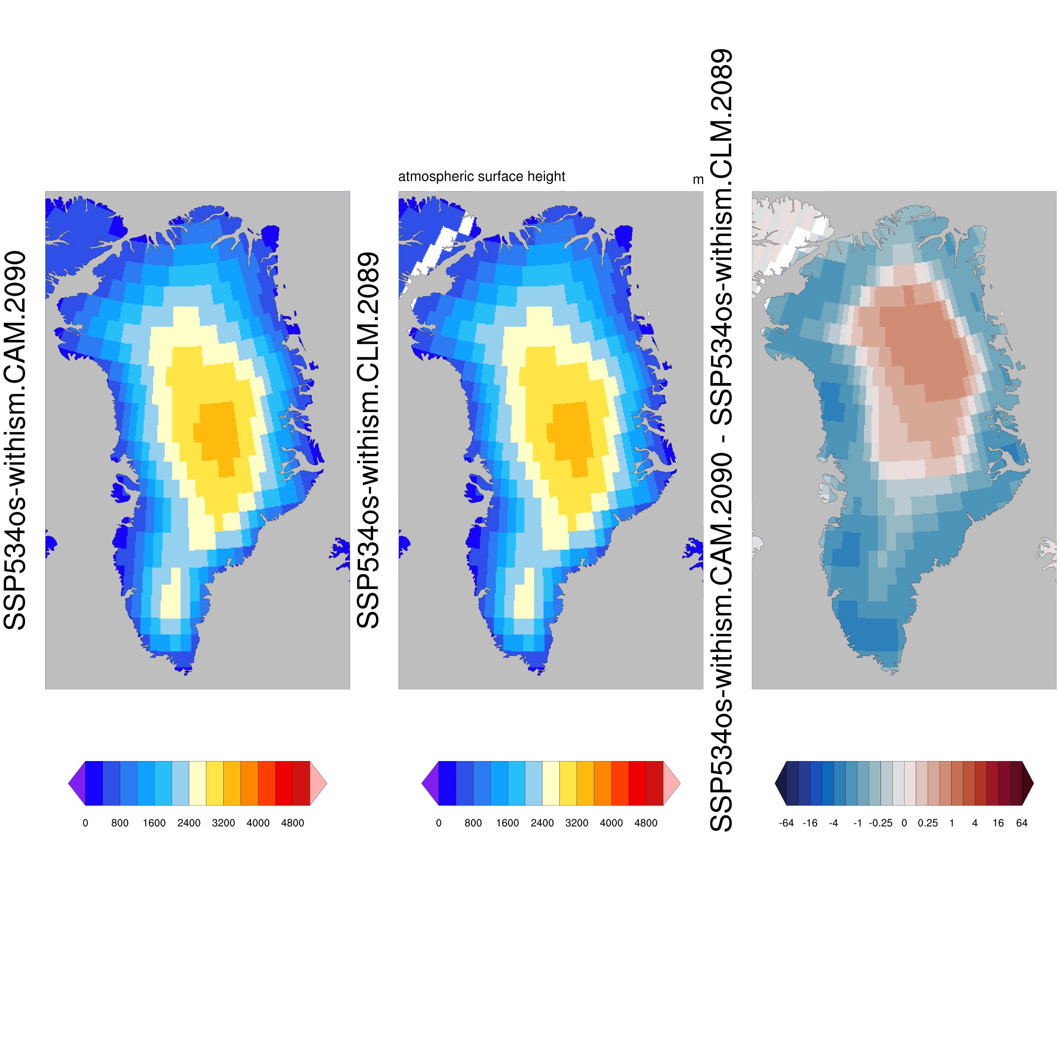
2089 – 2090 OK

Slide 7
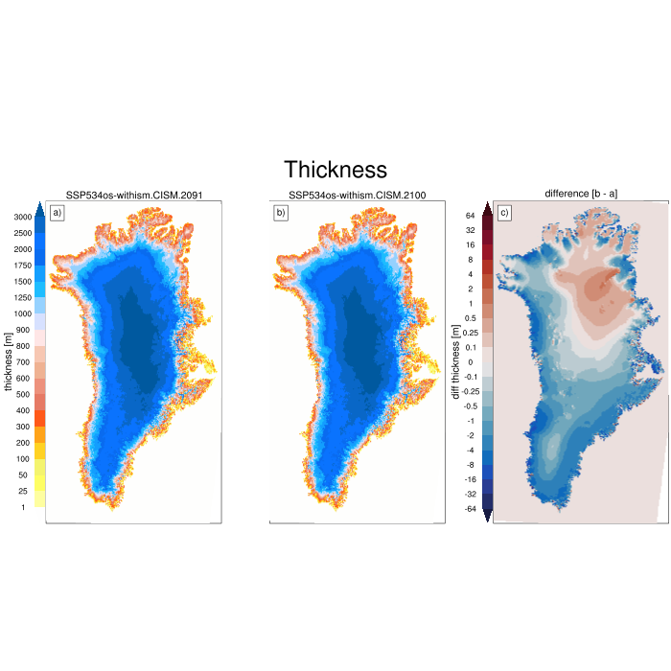
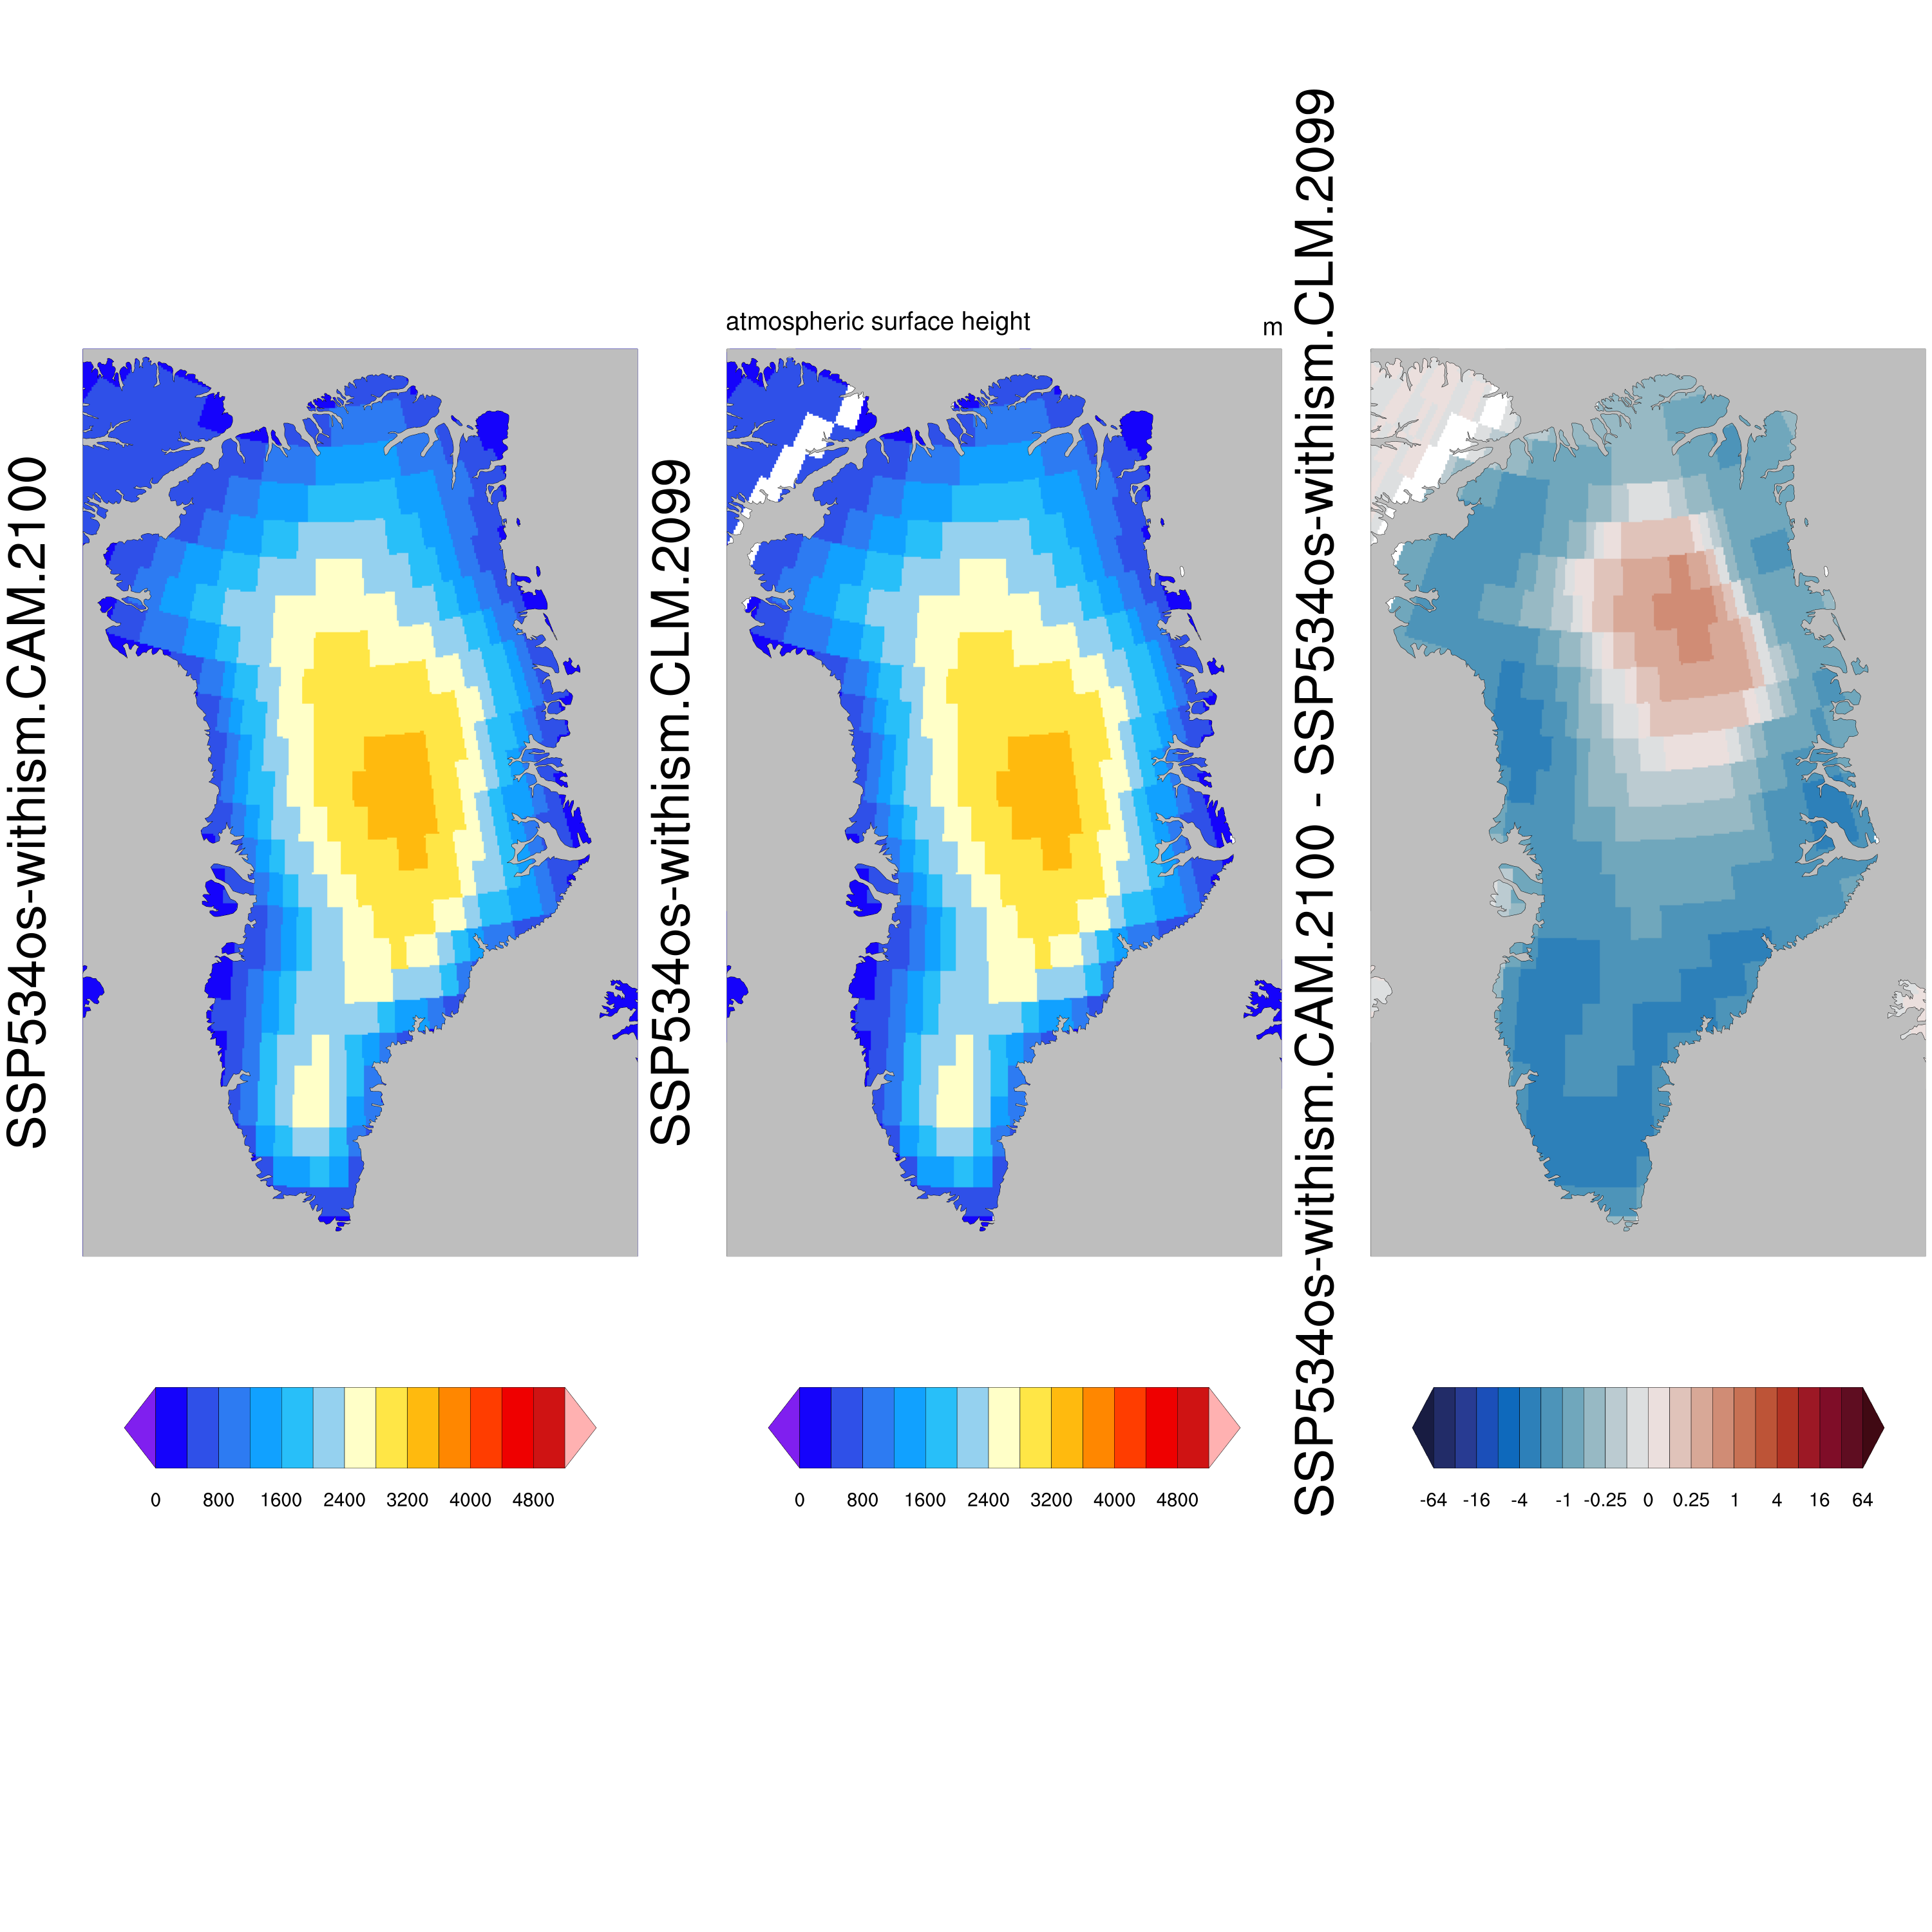
2099 – 2100 OK

